Slide 1



Vita Watch: Healthcare Alert System
ENGINEERING PROJECT
An intelligent healthcare risk prediction system leveraging machine learning to analyse vital signs and provide timely alerts for proactive health management
Prepared by Internal Guide
Department
Krishna School of Emerging Technology & Applied Research

Slide 2

Healthcare Monitoring & Risk Prediction
The Challenge
Healthcare monitoring addresses conditions influenced by multiple factors including age, lifestyle, genetics, and underlying health issues such as hypertension and respiratory anomalies.
Traditional approaches often lack real-time insights and accessibility, making early identification difficult.
Our Approach
This research leverages machine learning and data analytics to develop a Healthcare Risk Prediction System that evaluates the likelihood of health risks based on vital sign data including temperature, heart rate, and oxygen saturation.

Slide 3
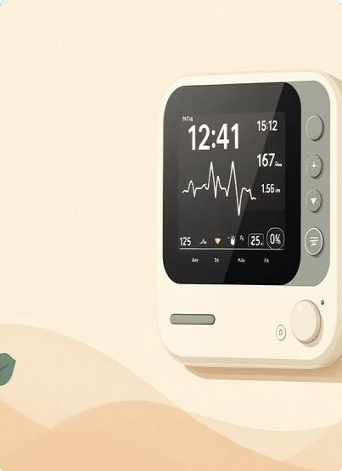

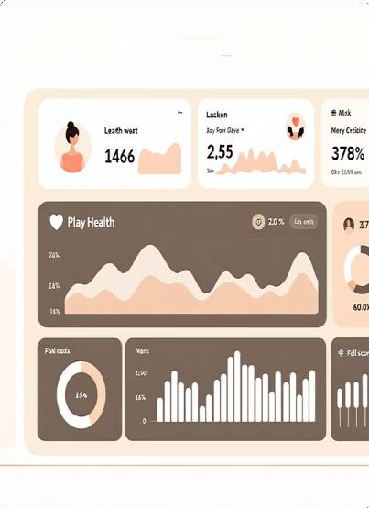
Research Focus & Innovation
Predictive Analytics
Analysing vital signs like temperature, heart rate, and oxygen saturation to predict risk levels with high accuracy
Personalised Recommendations
Offering tailored intervention and prevention strategies based on individual health profiles and risk assessments
Accessible Platform
Providing a user-friendly platform that enables proactive health management and supports timely medical decision-making

Slide 4
Health Risk Assessment Using Machine Learning
LITERATURE REVIEW
Publication Details
Journal: MDPI Electronics
Year: 2022
Focus: Systematic Review
90%
Model Accuracy
Random Forest algorithm performance
Research Objective
To develop and evaluate machine learning models for predicting healthcare risks using vital sign data, enabling early detection and intervention based on real-time health assessments.
Key Outcomes
Employed algorithms including Logistic Regression, Decision Trees, and Random Forest Achieved highest accuracy of 90% with Random Forest classifier
Identified key predictors: heart rate, temperature, blood pressure, and oxygen saturation Demonstrated effectiveness of ensemble methods for healthcare risk prediction

Slide 5

Additional Research Insights
A Catalogue of Machine Learning Algorithms for Healthcare Risk Prediction
Publication: MDPI Sensors (2022)
Research Objective
To analyse vital sign data comprehensively to identify and rank the key healthcare risk factors influencing patient outcomes.
Research Outcomes
Vital signs such as heart rate, temperature, and blood pressure significantly impact risk levels
Integration of real-time wearable device data enhances monitoring accuracy substantially
Proposed predictive model improves personalised healthcare risk assessment capabilities
Established foundation for continuous health monitoring systems

Slide 6




Comparative Analysis of ML Approaches
ANALYSIS
Systematic Review Study
Models: SVM, Random Forest, various ML algorithms
Catalogue Study
Models: Naïve Bayes, KNN, Random Forest, Neural Networks

Slide 7

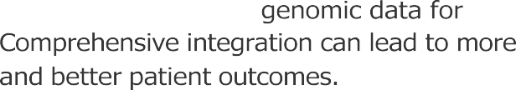



Identified Research Gaps
Dataset Integration
Real-Time Processing
Model Explainability

Slide 8



Healthcare Prediction Challenges
PROBLEM STATEMENT
Fragmented Data Sources
Limited Accuracy Models
Actionable, Explainable Insights
Real-time, Integrated System
Visual representation of the gap between existing systems and required healthcare prediction capabilities
The Challenge
Despite advancements in healthcare technology, accurately predicting patient health risks remains challenging due to the complexity and variability of medical data. Existing models often fail to integrate diverse health metrics, real-time data, and personalised factors.
The Need
Urgent requirement for a comprehensive healthcare classification system leveraging advanced ML techniques to provide real-time predictions and actionable insights.

Slide 9
Project Objectives
Our comprehensive approach to developing an effective healthcare risk prediction system encompasses multiple critical dimensions
01 02 03
Robust ML Model Development
Develop a robust machine learning model to classify patient health risks using a diverse healthcare dataset with high accuracy
Enhanced Transparency
Enhance model transparency and interpretability to ensure healthcare professionals can understand and trust the predictions
Comprehensive Data Utilisation
Utilise a variety of healthcare data sources for comprehensive analysis, ensuring holistic risk assessment
04
05
Scalable Architecture
Ensure the classification system is scalable and flexible to adapt to various healthcare settings and patient populations
Rigorous Validation
Validate the model's performance through thorough evaluation metrics and real-world testing to ensure clinical reliability

Slide 10


Post-Deployment Analytical Visualisations
ANALYTICAL OUTPUTS
Upon successful deployment, our system will generate a suite of analytical visualisations to provide continuous insights into patient health data and model performance. These visualisations are crucial for understanding data characteristics, model effectiveness, and informing clinical decisions.
Feature Distribution
Feature Heatmap
Confusion Matrix
negatives, false positives, and false negatives
model reliability and data quality assessment.
multicollinearity within the dataset to inform
Feature Importance
Ranks the significance of each feature in predicting health risks, offering crucial insights into which vital signs are most influential for early detection

